Slide 1
Question:
What are the contraindications, if any,
for the use of tranexamic acid (TXA)
during knee or hip arthroplasty?

Slide 2
Antony Palmer
Ibrahim Azboy
Matthew J Dietz
Alvaro Aunon
Serban Dragosloveanu
Ahmadali Ehsani
Ali Enayatollahi
Arezoo Ghamgosar PhD
Hikmet Cetin
Ramin Heshmat
Baran Demir
Cristian Scheau

Slide 3
Res Pract Thromb Haemost. 2021
Notes:
Tranexamic acid evidence and controversies: An illustrated review
Nicole Relke MD1 | Nicholas L. J. Chornenki MD1 | Michelle Sholzberg MDCM, MSc, FRCPC2,3,4

Slide 4
Why is this topic Important
Adoption of TXA > %95
Efficacy proven in blood loss blood transfusion
Safety profile still concerning

Slide 5
Mesh terms:
("Arthroplasty, Replacement, Knee"[Mesh] OR "Knee Injuries/surgery"[Mesh] OR "Knee/surgery"[Mesh])
("Arthroplasty, Replacement, Hip"[Mesh] OR "Hip Prosthesis"[Mesh] OR "Hemiarthroplasty"[Mesh] OR "Hip/surgery"[Mesh] OR "Osteoarthritis, Hip/surgery"[Mesh])
(Tranexamic Acid[Mesh] )

Slide 6
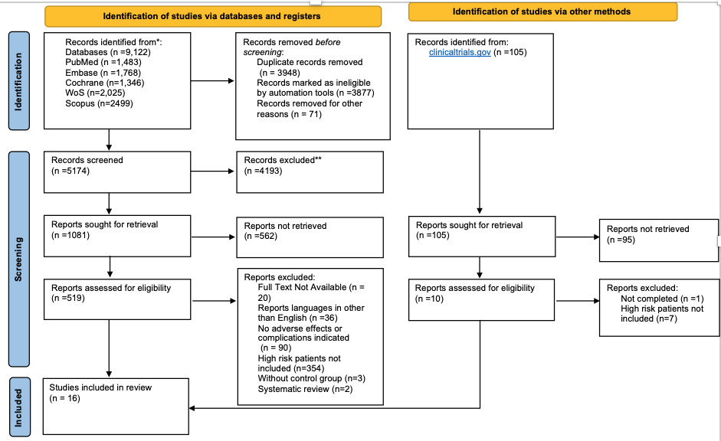

Slide 7
Rationale:
The safety of TXA in patients without a history of VTE or those at high risk for thrombotic events like MI, CVA, TIA, atrial fibrillation and/or vascular stent placement has already been proved by high quality evidence and has been endorsed by clinical practice guidelines. So, we performed a systematic review and meta-analysis in high-risk patients undergoing TJA to investigate the incidence of adverse effects of TXA utilization and compare those data with placebo or standard of care, irrespective of dose, route or timing of administration. We found moderate certainty evidence that the administration of TXA is safe in patients at high risk of thromboembolic events. While a history of hypersensitivity to TXA is the only absolute contraindication, we were not able to recommend for or against the use of TXA in patients with a history of seizure or visual disturbances due to the paucity of literature. Renal dysfunction is not a contraindication for the use of TXA but needs dose adjustment.

Slide 8
Recommendation:
A history of hypersensitivity to TXA is an absolute contraindication.
TXA can be safely administered in patients without a history of thromboembolic events.
Level of evidence: STRONG
In patients with a history of thromboembolic events, TXA can be safely administered.
Level of evidence: MODERATE

Slide 9
Recommendation: continue..
In patients with a history of seizure or visual disturbances we cannot recommend for or against the use of TXA.
Level of evidence: LOW
In patients with renal dysfunction, TXA is not contraindicated but dose adjustment according to serum creatinine level should be considered.
Level of evidence: STRONG

Slide 10
QUESTİON
What are the contraindications, if any , for the use of tranexamic acid (TXA)
during knee or hip arthroplasty?
Recommendation:
A history of hypersensitivity to TXA is an absolute contraindication.
In patients with a history of thromboembolic events, TXA can be safely administered.
In patients with a history of seizure or visual disturbances we cannot recommend for or against the use of
In patients with renal dysfunction, TXA is not contraindicated but dose adjustment according to serum creatinine level should be considered.

