Slide 1
What non-arthroplasty options are viable for patients with early-stage femoral head osteonecrosis?
Wenbo Mu, MD, Ph.D
First Affiliated Hospital of Xinjiang Medical University

Slide 2
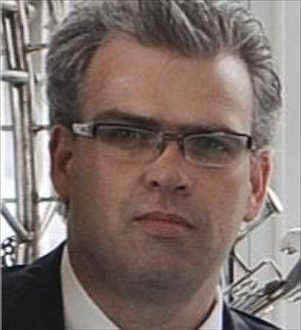
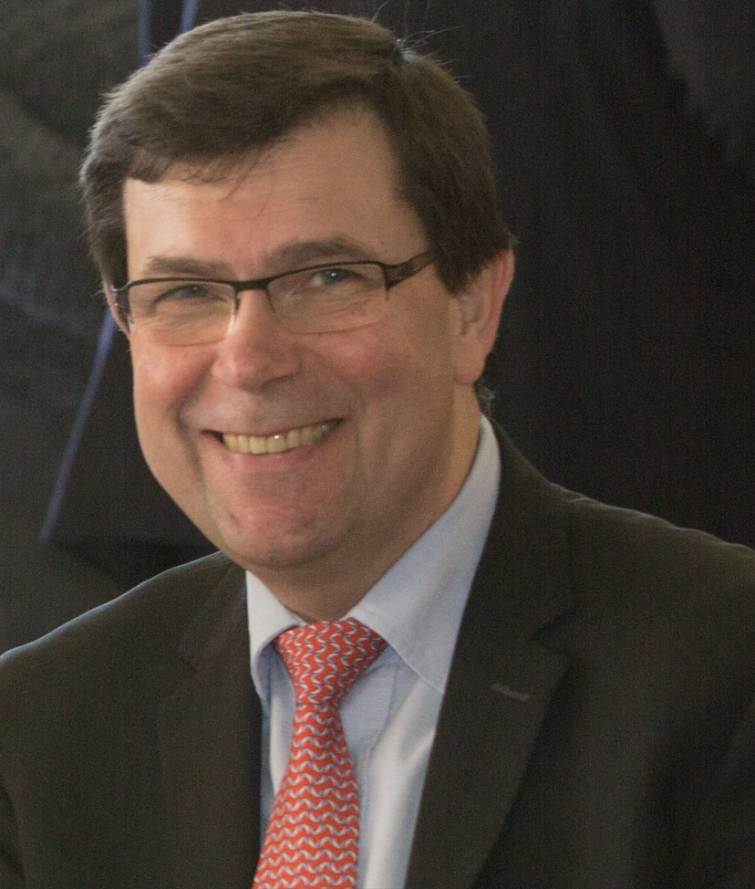
Amjad Hossain
Eoin Sheehan
George Babis
Marco Teloken
Michael Mont
Wei He
Wenbo Mu

Slide 3
Prevention of Disease Progression
Improving Patient Quality of Life
Early intervention with non-arthroplasty options can help prevent the progression of ONFH to advanced stages, delaying or avoiding the need for THA, which is particularly beneficial for younger patients.
Non-arthroplasty treatments can effectively reduce pain and improve mobility, enabling patients to maintain their daily activities and overall quality of life without resorting to invasive surgical procedures.
Cost-Effectiveness
Tailored Patient Care
These treatments are often more cost-effective compared to THA, offering a financial advantage for both healthcare systems and patients, especially in resource-limited settings.
Exploring non-arthroplasty options allows for a personalized treatment approach, addressing individual patient needs and preferences, which is crucial for those with specific comorbidities or those who are not ideal candidates for surgery.

Slide 4
Condition: ("Femoral Head Osteonecrosis" [MeSH Terms] OR "avascular necrosis of the hip" [All Fields] OR "aseptic necrosis of the femoral head" [All Fields])
Stage: ("Early Stage" [All Fields] OR "Initial Stage" [All Fields])
Intervention Type (excluding arthroplasty): ("Non-arthroplasty" [All Fields] OR "Conservative" [All Fields] OR "Medical Management" [All Fields] OR "Physical Therapy" [All Fields] OR "Bone Marrow Transplant" [All Fields] OR "Core Decompression" [All Fields] OR "Osteotomy" [All Fields] OR "Regenerative Medicine" [All Fields] OR "Mesenchymal Stem Cells" [All Fields] OR "specific drug" [All Fields] OR "new regenerative technique" [All Fields])
Combination of Condition and Stage: 1 AND 2
Combination of Intervention Terms: 3
Linking Condition/Stage with Interventions: 4 AND 5
Filter for Study Designs: ("clinical trial" [Publication Type] OR "observational study" [MeSH Terms] OR "case report" [MeSH Terms] OR "cohort study" [MeSH Terms] OR "cross-sectional study" [MeSH Terms] OR "case-control study" [MeSH Terms] OR "comparative study" [MeSH Terms])
Combine with Study Designs: 6 AND 7
Exclude Animal Studies: 8 AND "humans" [MeSH Terms] NOT "animals" [MeSH Terms]

Slide 5
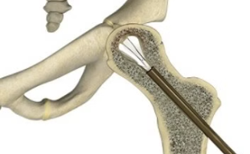
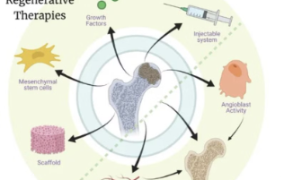
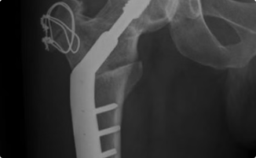
Physical Therapy and Lifestyle Changes
Medications
Core Decompression
Biological Treatments
Osteotomy

Slide 6
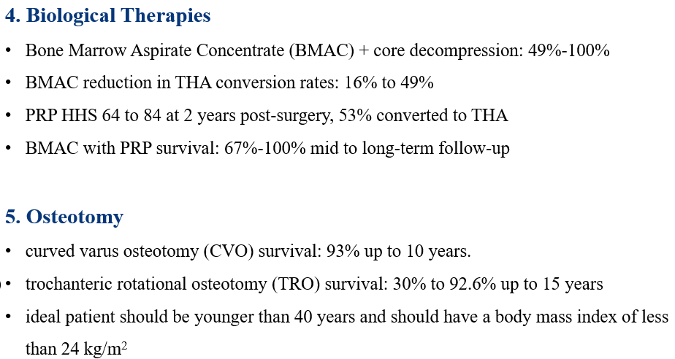

Slide 7
Question :
What non-arthroplasty options are viable for patients with early-stage femoral head osteonecrosis

Slide 8
Rationale:
Early intervention is crucial to prevent femoral head collapse and maintain joint function.
Pharmacological treatments, such as bisphosphonates and teriparatide, are shown to slow disease progression.
Core decompression, often enhanced with biological therapies like Bone Marrow Aspirate Concentrate (BMAC) and Platelet-Rich Plasma (PRP), facilitates bone regeneration.
Osteotomies are used to redistribute weight-bearing forces, thereby protecting healthy bone and delaying the need for more invasive procedures.

Slide 9
Question
What non-arthroplasty options are viable for patients with early-stage femoral head osteonecrosis?
Response
Physical therapy and lifestyle modifications are fundamental in preventing disease progression.
Pharmacological treatments, core decompression techniques, biological therapies, and osteotomies should be tailored to individual patient needs to optimize outcomes.

