Slide 1
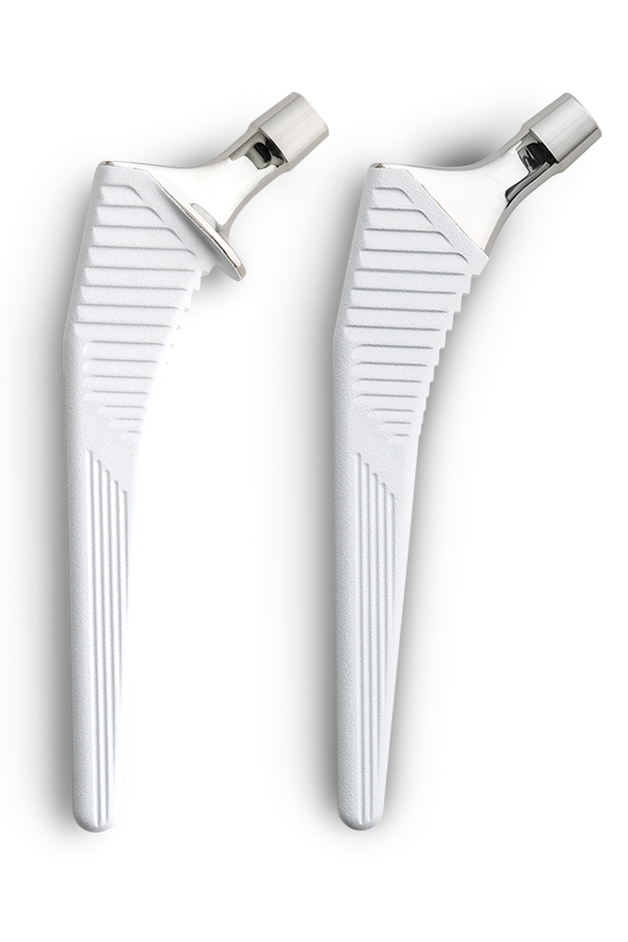
“Is there a difference in outcomes between collared and non-collared uncemented femoral stems in primary total hip arthroplasty?”
Levent Bayam, MD, MCh(T&O), MPhil, MSc, FEBOT
Medipol University Orthopedics and traumatology department

Slide 2
Bayam L
Karaytug K
Feng E
Marin-Pena O
Murcia A
Rana A
Romanini E
Tozun R

Slide 3
Why is this topic Important?
Higher revision rates after total hip arthroplasty (THA) being reported for uncemented stems.
There is still no clear consensus regarding uncemented collarless or collared femoral stem designs.
The aim of this review is to investigate the influence of collar of femoral stem in uncemented THA.

Slide 4
Literature Review/Process
Mesh terms used
(((((((((((hip) OR (femoral)) AND (stem)) OR (arthroplasty)) OR (hip arthroplasty)) AND (cementless))) OR (uncemented)) AND (collar)) OR (collared)) OR (collarless)) AND (outcome)
Number of articles retrieved:755
Screening: 264
Final number of publications:18
400 PubMed 205 MEDLINE 125 Embase 25 CENTRAL

Slide 5
Literature Review/Process
This review included 18 studies, conducted over the last 5 years including 7 national registry studies
( American, Australian, German, Norwegian, and UK)
4 systematic reviews (two of which with meta-analysis) with a high volume of patients studied that ranged from 59,518 to 337,647 hip replacements patients (more than 1 million TJA).
The rest were comperative high volume studies

Slide 6
Findings from Literature
What did literature reveal
Use of both collared and non-collared uncemented femoral stems results in an excellent clinical outcome in patients undergoing total hip arthroplasty.
Rate of periprosthetic fractures is lower for the collared stems despite similar survivorship

Slide 7
Question:
Is collared stem better choice in primary uncemented hip arthroplasty than collarless stem?

Slide 8
Rationale:
The findings from literature demonstrated;
excellent survivorship rates
similar radiographic and functional outcomes, and
overall complication rates for both collared and non-collared stems.

Slide 9
Rationale:
The findings from literature demonstrated;
A significant difference between the two stems with regards to
the rate of periprosthetic fracture,
subsidence, and
rotational instability,
with data favoring collared uncemented femoral stems

Slide 10
Rationale:
The findings from literature demonstrated;
However, subsidence may not be clinically relevant as the revision rate is similar
Some articles may have bias on a particular stem type.

Slide 11
Question:
Is collared stem better choice in primary uncemented hip arthroplasty than collarless stem?
Response:
Use of collared stem (at least the one common stem that was evaluated) results in a reduction in the rate of periprosthetic fracture
Surgeons starting to familiarize themselves with the use of a femoral stem at the start of their carrier may want to consider these findings that may influence their choice of a femoral stem.

