Slide 1
Question 43:
Is there a limit to limb lengthening in patients with Crowe IV developmental dysplasia of the hip undergoing total hip arthroplasty?

Slide 2
Dr. I. Ganzoury
Dr. Vahit Ozden
Dr. V. Atipiboonsin
Dr. O. Chaar
Dr. O Bilgen
Dr. A. Younis
Dr. Jesus M Suárez
Dr. Yanguo Qin
Dr. M. Ghazavi

Slide 3
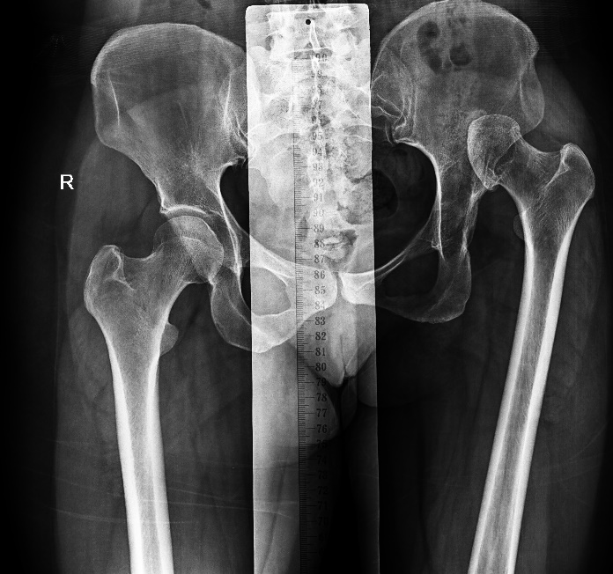
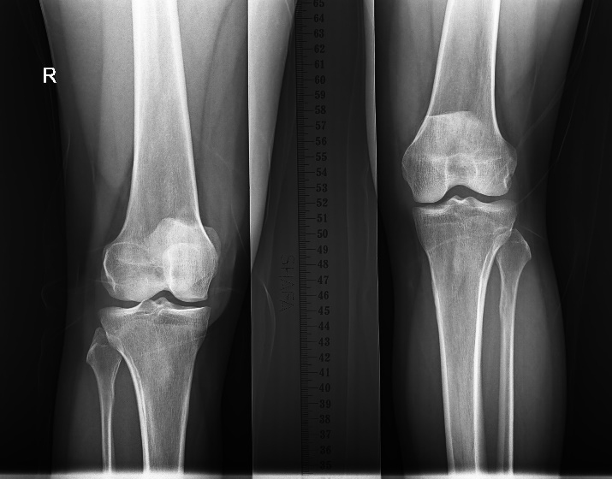
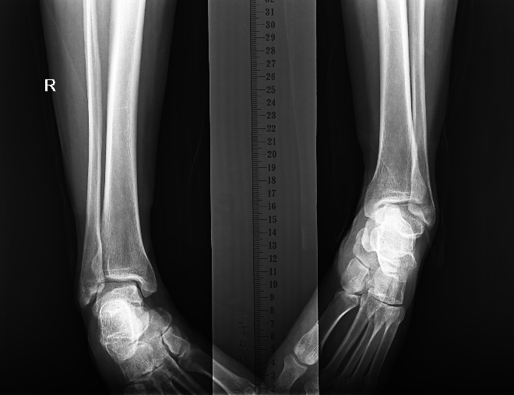
Why is this topic Important:
Sciatic nerve palsies are the most common neurologic injuries following THA
Overall incidence 0.6 to 3.8%
Unknown etiology in about 50%
Significantly impair the clinical success of an otherwise excellent THR procedure
Malpractice claims is a significant portion of all THA related claims. (19.6%)

Slide 4
Why is this topic Important continue….:
Patients expect to have equal limbs
DDH is a risk factor for nerve damage in THA
Insertion of hip in anatomic position causes
Lengthening of the limb.
Stretching of the soft tissue structures including nerves
Previous historical reports and empirical evidences suggest that 3-4 cm lengthening poses the higher risk of neurologic injuries.
Evidences are confusing and conflicting.
[Marcello De Fine,et al BioMed Research International Volume 2017, Article ID 8361071, 7 pages https://doi.org/10.1155/2017/8361071]

Slide 5
Literature Review/Process
Mesh terms used:
"arthroplasty replacement hip"[All Fields] OR "arthroplasty"[All Fields] OR "hip prosthesis"[All Fields] OR "hip"[MeSH Terms] 134,783 Articles
"total hip replacement"[Title/Abstract] OR "total hip arthroplasty"[Title/Abstract] OR "hip arthroplasty"[Title/Abstract] OR "hip replacement"[Title/Abstract] "[MeSH Terms] 43,843 Articles
#1 OR #2 137,669 Articles
"hip dysplasia"[Title/Abstract] OR "developmental dysplasia of the hip"[Title/Abstract] OR "dysplastic hip"[Title/Abstract] OR "congenital dysplasia of the hip"[Title/Abstract] OR (("Crowe"[All Fields] OR "crowe s"[All Fields]) AND "four"[Title/Abstract]) OR “Crowe IV"[Title/Abstract] 6,981 Articles
"congenital hip dislocation"[All Fields] OR "hip dislocation"[All Fields] OR "congenital hip dysplasia"[All Fields] OR "developmental dysplasia of the hip"[MeSH Terms] 16,364 Articles
#4 OR #5 19,135 Articles
#3 AND #6 1733 Articles

Slide 6
Literature Review/Process
Number of articles retrieved
1733 studies
Screening
419 studies remained for screening
Final number of publications
91 studies used for publication

Slide 7
What did literature reveal:
Lengthening & Nerve Damage
Different and confusing amounts of lengthening reported that could increase risk of neurological complications.
> 20 mm?
> 35 mm [49].
> 40 mm [Hanssen AD et al Myo Clinic Report, 1991, pp 897-905.]
> 50 mm [92].
8.7% of the femoral length [44]. Kabata et al. 2018 ?
Lengthening threshold cannot be surely identified before neurologic damage occurs

Slide 8
What did literature reveal:
Risk Factors for Sciatic Nerve Palsy
DDH (Specially Crowe IV)
Previous hip surgery
Female Patients

Slide 9
What did literature reveal
Risk Factors: Patient-Specific Conditions
Some other patient-specific conditions or comorbidities might also influence the risk of nerve injury
Degree of hip flexion contracture
previous hip surgeries
Prior spine surgery or diseases might increase the risk of neurological complications [93][94].

Slide 10
What did literature reveal
Preventive Measures: Shortening Osteotomies
Fifty-eight studies used femoral shortening (mean lengthening of 18.8 to 51 mm)
The indications and role of these types of osteotomies remain unclear.
Thirteen studies, no shortening (mean limb lengthening 21 to 48 mm)
Nine studies, staged procedures, (mean limb lengthening ranging from 36 to 100 mm)
Maintaining hip and knee in flexed with gradual knee extension. 40 mm lengthening, (29-62 mm) [12] Yan et al. 2018

Slide 11
What did literature reveal
Preventive Measures: Intra-op Measures
Thirteen studies, no shortening (mean limb lengthening 21 to 48 mm)
Nine studies, staged procedures, (mean limb lengthening ranging from 36 to 100 mm)
Maintaining hip and knee in flexed with gradual knee extension. 40 mm lengthening, (29-62 mm) [12] Yan et al. 2018

Slide 12
What did literature reveal
Intra-op Nerve Monitoring (INOM)
Nerve monitoring [81] Shemesh et al. 2017
Decreases the incidence of nerve palsy
Determines need for femoral shortening osteotomies
Less incidence of nerve palsies in when used INOM [73] Kong et al. 2019

Slide 13
Findings from Literature
Our Important Findings: Lengthening & Nerve Damage
Limited and Conflicting evidences about the limit of limb lengthening after which the risk for neurological complication increases.
Confusing and conflicting reports of hazardous amounts of lengthening that causes nerve damage.
Evidences on “no relationship between lengthening and nerve damage”.
Marcello De Fine et al BioMed Research International Volume 2017

Slide 14
Findings from Literature
Our Important Findings: Preventive Measures:
Some measure could help prevent nerve damage:
Nerve monitoring
Femoral shortening osteotomy
keeping knee in flexion
Gradual or two stage procedure

Slide 15
Question 43:
Is there a limit to limb lengthening in patients with Crowe IV developmental dysplasia of the hip undergoing total hip arthroplasty?

Slide 16
Rationale:
We did a systematic review on this question. A total of 91 articles reviewed. All studies were prospective or retrospective cohorts and some case reports. Studies revealed that hip arthroplasty although difficult and complex but is indicated and effective in the treatment of symptomatic hips in Crowe type IV developmental dysplasia of the hip. In order to insert the cup in anatomic position lengthening of the limb is necessary. Diagnosis of DDH, previous hip surgery and being female are main risk factors for nerve damage. There is no known etiology for postoperative nerve damage in 50% of the patient. There are conflicting evidences on the amount of lengthening that could cause nerve damage. Some studies revealed increased risk after lengthening of more than 8.7% of the length of femur. There are different measures to decrease the risk in these patients. Shortening osteotomies, nerve monitoring, gradual lengthen in two stages and keeping the knee in flexion and gradual extension could decrease the risk of nerve damage.

Slide 17
Question
Is there a limit to limb lengthening in patients with Crowe IV developmental dysplasia of the hip undergoing total hip arthroplasty?
Response:
The review of current literature does not identify a specific limit to limb lengthening. The traditional limit of 4 cm (or similar numbers) are based on older historical or empirical evidences with some methodological deficiencies.
Level of evidence: Low

