Slide 1
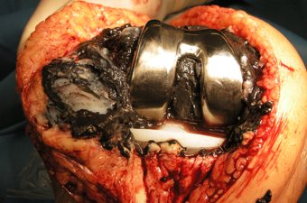
Does Metal Allergy to Total Knee Arthroplasty Components Exist?
Valentin Antoci Jr. MD PhD
Chief, Division of Adult Reconstruction
Brown University, Providence, USA
HEALTH

Slide 2
SM Javad Mortazavi
Eleftherios Tsiridis
Valentin Antoci
Ismet Gavrankapetanović
Sam Tarabichi
Alfredas Smailys
Pooya Hosseini-Monfared
Shang Wen Tsai
Mohammadreza Razzaghof
Socorro N

Slide 3
METAL ALLERGY – WHY IS IT IMPORTANT
“SHOULD I REVISE THIS IMPLANT?”
15-25% of total knee patients are not satisfied with their outcome
the incidence of metal allergy was reported to be around 10 to 20% in general population
prevalence of positive skin patch tests (SPT) demonstrated a pooled prevalence of 25 % among the patients who underwent total joint arthroplasty
Type IV or delayed type hypersensitivity is considered to be T-lymphocyte mediated which could lead to complications such as osteolysis and endoprosthetic loosening
Is it real? Do we know? … and what should we do with the patients

Slide 4
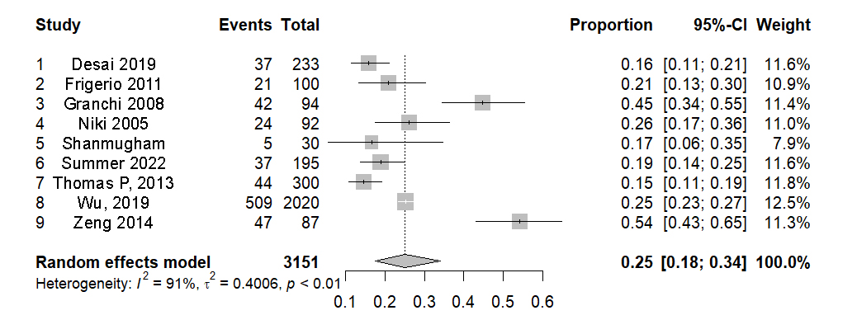
Literature Review
9 studies, 15-54% metal hypersensitivity, high heterogeneity, 25% pooled prevalence

Slide 5
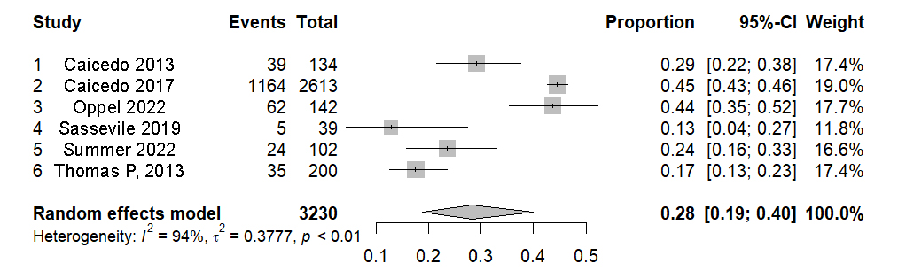
Literature Review
6 studies with symptomatic TKA, 28% metal sensitivity, 0.6-1% revision rate

Slide 6
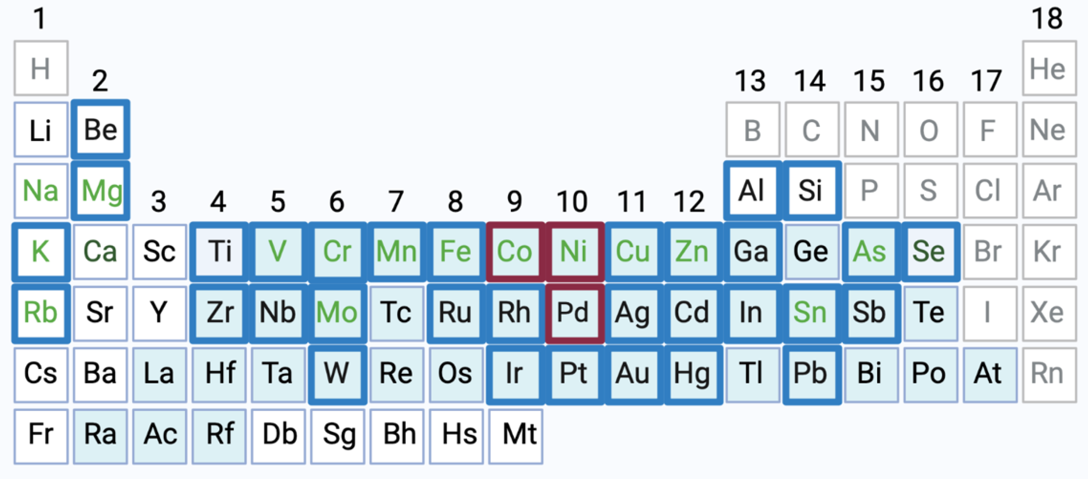
Conclusions
Although the incidence rate of metal hypersensitivity is higher among the patients who underwent total joint arthroplasties, these allergies are not necessarily associated with implant failure.
Since there are reports of patients who tolerated the metal implants regardless of the presence of metal hypersensitivity, a general metal allergy screening is not recommended

Slide 7
Question
Does Metal Allergy to Total Knee Arthroplasty Components Exist?
Response
While hypersensitivity-related complications after total joint arthroplasty likely exist, revision surgery for metal hypersensitivity alone is not recommended
Positive skin test is not an indication for revision surgery
Routine testing for metal allergy is not recommended

