Slide 1
Who are suitable candidates for isolated patellofemoral arthroplasty?
Murat Bozkurt¹, Anil Pulatkan², Nikolai Kornilov³, Simon Coffey⁴, Hatem Bakr⁵, Badrul Shah Badaruddin⁶, Peilai Liu⁷, Nilo Paner⁸, Christian Merle², Wenzel Waldstein², Peter Aldinger²
¹ Acibadem Ankara Hospital, Department of Orthopedics and Traumatology, Istanbul, Turkey
² Diakonie-Klinikum Hospital, Department of Orthopedics and Traumatology, Stuttgart, Germany
³ Vreden National Medical Research Center of Traumatology and Orthopedics, Ministry of Health of Russian Federation, St. Petersburg, Russian Federation
⁴ Department of Orthopaedics, Nepean Hospital, Penrith, NSW, Australia
⁵ Orthopaedic and Traumatology Department, Assiut University Hospital, Assiut, Egypt
⁶ Department of Orthopaedics and Traumatology, Prince Court Medical Centre, Kuala Lumpur, Malaysia
⁷ Department of Orthopaedics, Qilu Hospital of Shandong University, Jinan, 250102, China
⁸ Department of Orthopedics, University of the Philippines Manila, Metro Manila, Philippines

Slide 2
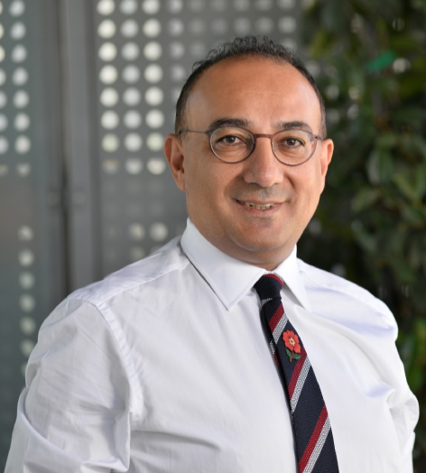
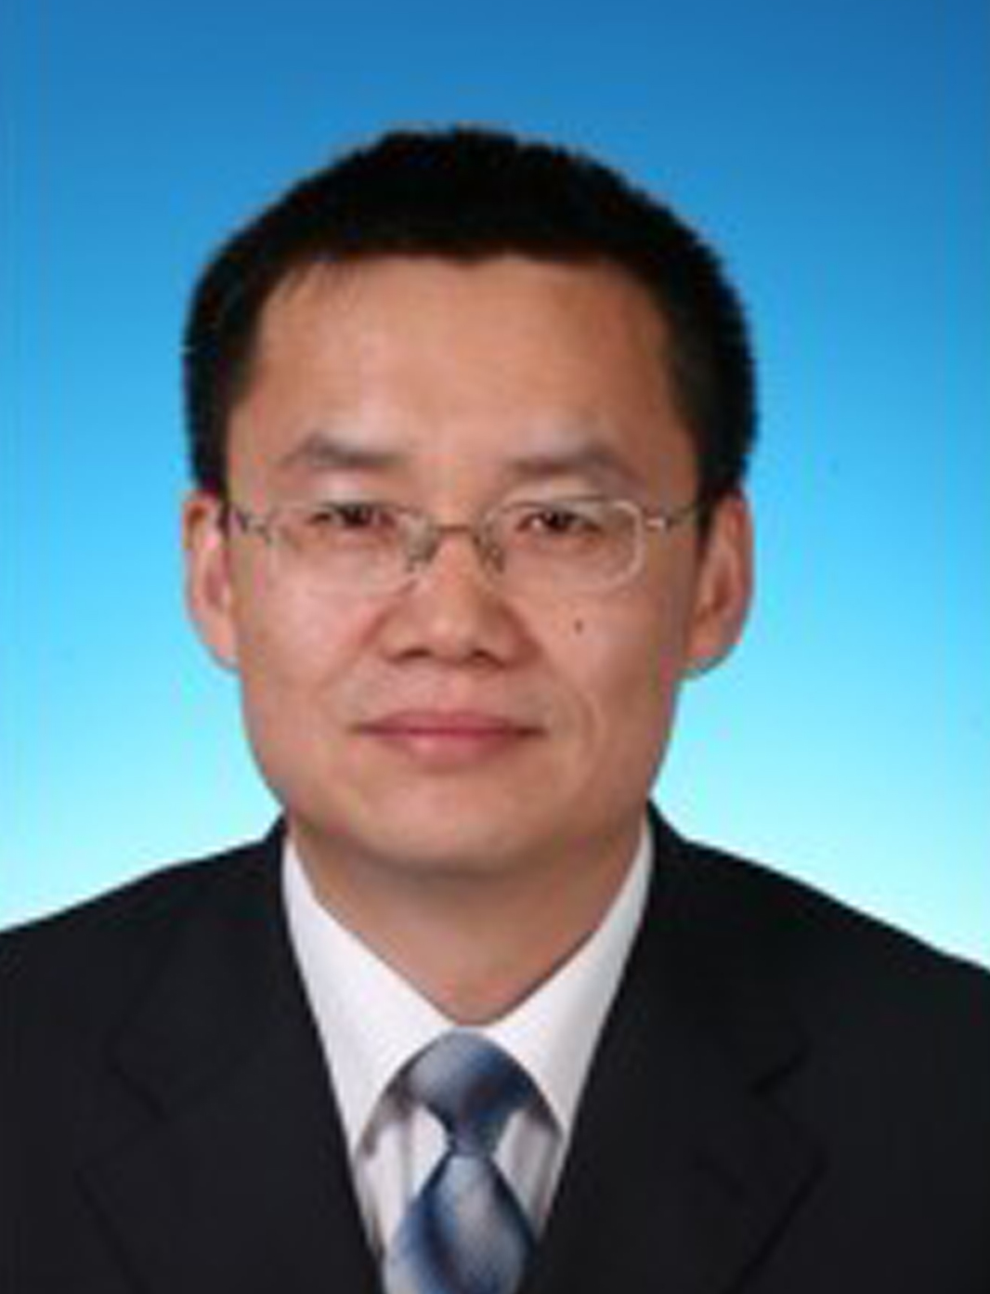
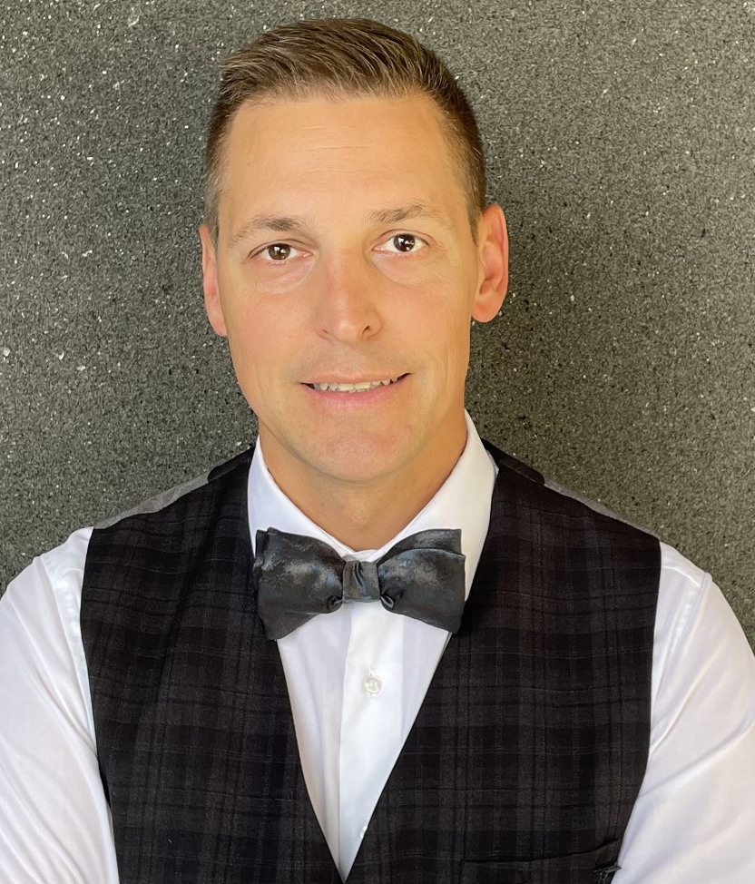

Slide 3
Who are suitable candidates for isolated patellofemoral arthroplasty?
PFA offers ↑ functional results & bone / soft tissue conservation, but ↑ revision rate compared to TKA
Patient selection is the most important element ➜ satisfactory long-term outcome for isolated PFJ-OA
Number of PFA ↓ compared to TKA due to inappropriate patient selection, which results in ↑ patient dissatisfaction as well as ↓ improvement in PROMs
Questions remain about who is a candidate for PFA?

Slide 4
Pubmed search for “Patellofemoral arthroplasty“ or “Patellofemoral replacement“ and “indication“
(n=192) studies
- 87 of records excluded
(not focused or not relevant on the topic)
66 excluded after title review
21 excluded after abstract review
105 records reviewed and screened
- 89 of records excluded after full text review
(not focused or not relevant on the topic)
16 articles assessed for eligiblity
Total included references (n=16)

Slide 5
Findings from PFA Literature
Asking about family history of early OA to evaluate risk factors for OA progression
Conservative treatment for a minimum of 3-6 months
Pain <1 year a risk factor for ↓ PROMs
Psychosocial status is important for PROMs (Smoking, opioids or antidepressants are risk factors for ↓ improvement of functional outcomes)
Functional outcomes of advanced-stage PFJ-OA (Ivano Grade 3-4) > early stages diagnosed on MRI
Preop. use of MRI (focus should be on TFJ) and CT (PFI or rotational disorders) are controversial
Preoperative technetium bone scanning exclude TFJ-OA more reliably than MRI

Slide 6
Findings from PFA Literature-II
10º flexion contracture and flexion <110º → contrandication for PFA
↑ failure rate, ↓PROMs in obese patients because of progression of OA to TFJ Trochlear dysplasia (best indication for PFA ) is a strong risk factor for PFJ-OA.
Prior meniscectomy and ACL reconstruction are not contraindications for PFA (Instability=OA risk↑) prior op.→infection? (early failure)
Coronal plane deformity → progression to TFJ-OA
Lack of surgeon's experience, ↑ Q angle, additional cartilage lesions, patellofemoral dysplasia, or patellar maltracking might be poor prognostic factor

Slide 7
Controversies from PFA Literature-II
Knowledge vs Experience → a shared decision with the patient
Ideal age for PFA?
BMI cut off (30-35)?
Coronal plane deformity cut off (>Valgus 8° and varus 5° or >3°)
Is patella baja a contraindication?
Prior ACL reconstruction patients may be at high risk for progression of TFJ-OA?
Staged or simultaneous extensor mechanism realignment surgery is associated with better
results in patients with PFJ-OA and extensor mechanism malalignment

Slide 8
Question
Who are suitable candidates for isolated patellofemoral arthroplasty?
Response
PFA is a successful treatment for isolated end stage PFJ-OA in patients who do not respond to conservative treatment, are not obese, have no signs of TFJ-OA, do not have coronal plane deformity and especially in those with trochlear dysplasia

