Slide 1
Does Integration of Robotic Technology Improve Outcomes in unicompartmental Knee Arthroplasty?
Kayahan KARAYTUG, MD. Acibadem MAA University, International Joint Center (IJC)

Slide 2
Liaison: Experts:
Kayahan Karaytug
Emrah Caliskan
Mohammad K. Abdelnasser
Rami M. Sorial
Atul Kamath

Slide 3
Why is this topic Important?
Robotic-assisted UKA (R-UKA) is a method gaining popularity.
It is claimed to have superiority over the conventional method (C-UKA) in component positioning and accuracy thanks to real-time feedback.
It is stated that it is not superior to C-UKA in terms of cost and patient reported functional outcomes.
This “umbrella review” was prepared to compare R-UKA to C-UKA.

Slide 4
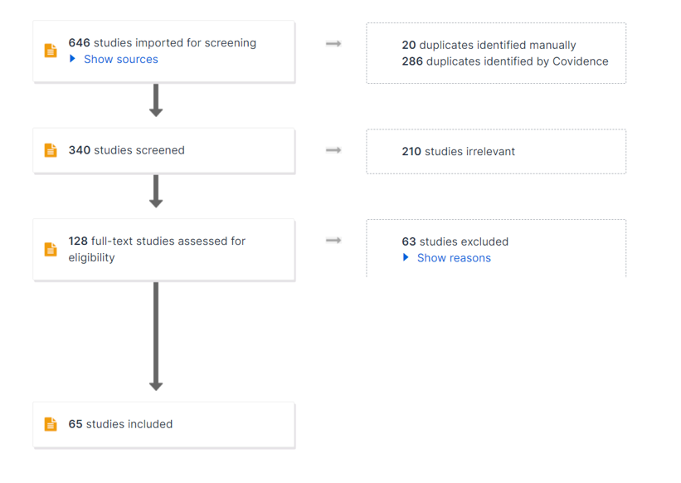
Literature Review/Process
Cochrane
Embase
Ovid-medline
Pubmed
14 meta-analyses
34 comparative studies
12 syst. Review
5 RCT

Slide 5
Literature Review/Process
We did an umbrella study (review of reviews) on a total of 14 meta-analyses comparing R-UKA and C-UKA in terms of their superiority over each other.
10/14 were systematic reviews and meta-analyses,
3/14 were meta-analyses,
1/14 was a network meta-analyses.
The included studies were published between 2016-2023, which covered the results of the original articles from 2005 to 2023.

Slide 6
Question:
Does The Integration of Robotic Technology Improve Outcomes in unicompartmental Knee Arthroplasty?

Slide 7
1- Radiological outcome
R-UKA is associated with better accuracy with decreased number of outliers ( 8 meta-analyses)
No difference (1 meta-analysis)
2- Clinical outcome
No difference ( 8 meta-analyses)
R-UKA is associated with better clinical outcome scores (2 meta-anlyses)
3- complications
R-UKA is associated with decreased complications ( 3 meta-analyses)
NO difference (1 meta-analysis)

Slide 8
4- Revision rate
R-UKA is associated with decreased revision rate ( 2 meta-analyses)
No difference (1 meta-analyses)
5- operative time
R-UKA is associated with increased operative time (4 meta-analyses)
6- Cost
The cost of R-UKA is higher.
Both R-UKA and C-UKA approach comparable costs in high volume centers where > 100 cases/year are performed.

Slide 9
Literature Review conclusion
R-UKA is more successful in terms of precision
R-UKA is more accurate for implant alignment.
R-UKA and C-UKA have similar functional outcomes.
R-UKA brings higher costs. However, both R UKA approach comparable costs with C-UKA in high volume centers where > 100 cases/year are performed

Slide 10
Question:
Does The Integration of Robotic Technology Improve Outcomes in unicompartmental Knee Arthroplasty?
Response:
R- UKA offers several significant technological advantages, including precision and accuracy, repeatability, reliability, and real-time feedback.
C-UKA was associated with shorter operative time and lower cost.
the benefits of using robotics should be weighed against the added cost and longer operative time.

