Slide 1
Is Prescribed Postoperative Physical Therapy Necessary after Routine Primary Total Knee or Total Hip Replacement?
Claudio Diaz Ledezma, MD
University of California San Francisco

Slide 2
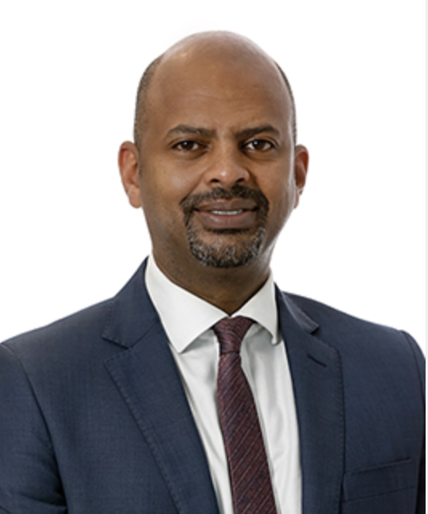
Khalid Merghani
Ilda Molloy
Rob Nelissen
Lipalo Mokete
Julian Costantini

Slide 3
Why is this topic Important
Postoperative Physical Therapy has been a consuetudinary practice for decades
Responsible for 8% of the cost in TJA
Remarkable variability
Recent recognition of the success observed with self-directed postoperative programs, modality that might be difficult to incorporate in some scenarios due to a variety of factors

Slide 4
Literature Review/Process
Physical Therapy Modalities AND knee arthroplasty
Physical Therapy Modalities AND hip arthroplasty
1433 (knee) & 874 (hip)
Clinically relevant according to our panel of experts
Final number of publications: 30

Slide 5
Findings from Literature
Postoperative PT remains an essential component of standard care after TJA
PT approach should be individualized
Self-directed programs and Prescribed supervised programs are both successful when indicated in the appropriate patient and scenario

Slide 6
Question:
Is Prescribed Postoperative Physical Therapy Necessary after Routine Primary Total Knee or Total Hip Replacement?

Slide 7
Rationale:
Our narrative literature review revealed moderate evidence supporting the efficacy of unsupervised, self-directed exercise therapy as a safe alternative to prescribed, traditional, supervised physical therapy for patients undergoing hip or knee replacement.
However, prescribed supervised programs remain essential for patients who are unable to adhere to the requirements and structure of self-directed programs.

Slide 8
Question:
Is Prescribed Postoperative Physical Therapy Necessary after Routine Primary Total Knee or Total Hip Replacement?
Response:
No. Prescribed supervised postoperative physical therapy may not be necessary for all patients undergoing routine total joint arthroplasty when a structured self-directed program can effectively meet their needs and expectations

