Slide 1
Should intravenous steroids be administered during routine primary knee or hip arthroplasty?
Armita A. Abedi, International Consensus Meeting Fellow

Slide 2
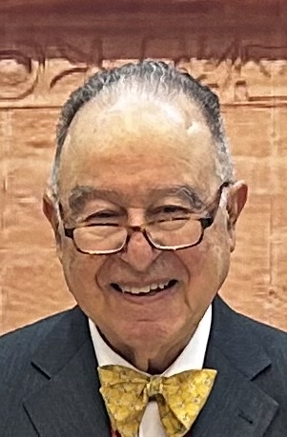
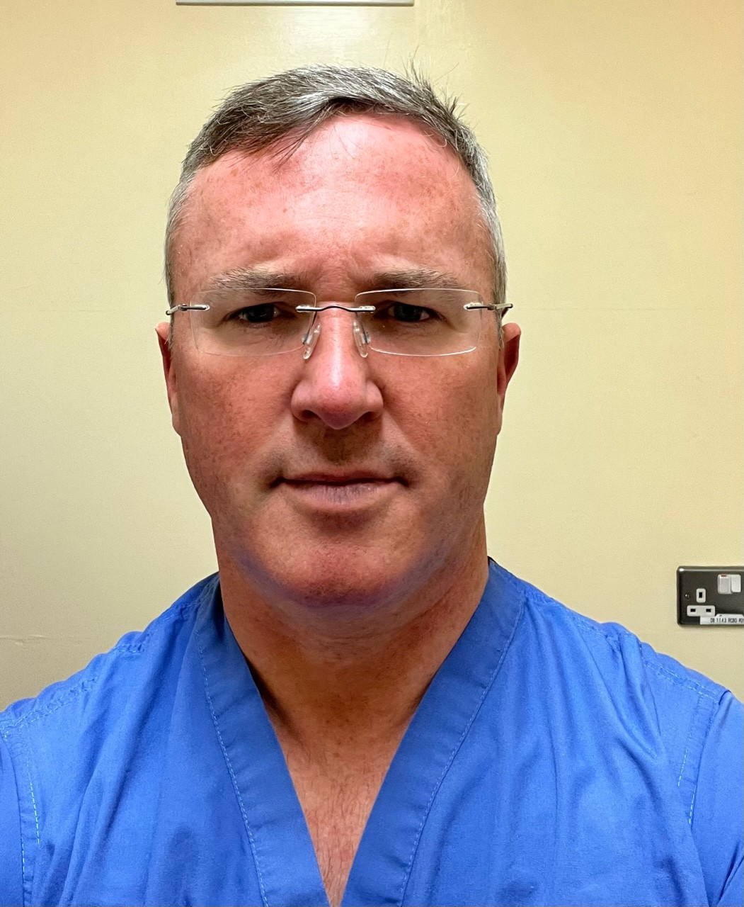
The Experts

Slide 3
Why is this topic Important? Key for optimizing evidence-based practices in surgical recovery & pain management
Postoperative pain, nausea and vomiting (PONV) are common challenges for patients undergoing total hip arthroplasty (THA) and total knee arthroplasty (TKA)
Inadequate pain control and PONV: significantly prolong recovery and diminish patient satisfaction
Optimizing pain management and reducing PONV are critical for enhancing postoperative care protocols and patient outcomes

Slide 4
Literature Review
No. hits PubMed: 323
No. hits EMBASE: 651
No. hits Cochrane: 412
Search Strategy:
Combination of terms: Steroids AND Intravenous AND Arthroplasty
Mesh Terms:
No. after removal of duplicates: 1036
Screening title & abstract for eligibility.
Exclusions: 933
Population | Intervention (1) | Intervention (2)
Arthroplasty | Steroids | Intravenous
Arthroplasty, replacement, knee | Cortisone | Administration, Intravenous
Arthroplasty, replacement, Hip | Dexamethasone | Injections, Intravenous
Joint prosthesis | Hydrocortisone
 | Methylprednisolone
 | Bethametasone
 | Adrenal Cortex Hormones
Total no. after exclusion: 103
Included in This Recommendation: 21
2 high quality guidelines
2 meta-analyses
12 RCTs (+ 2 follow-ups)
3 Large retrospective studies

Slide 5
Findings from Literature
Strong evidence supporting the efficacy of iv steroids in reducing:
postoperative pain
opioid consumption
nausea/vomiting
There is also evidence, that administration of IV steroids does not increase the risk of:
adverse or serious adverse events within the first 90 days postoperatively

Slide 6
Question:
Should intravenous steroids be administered during routine primary knee or hip arthroplasty?

Slide 7
Response:
Yes. Administration of iv steroid is safe and effective for postoperative recovery following total joint arthroplasty
Whenever feasible we recommend:
iv dexamethasone at a dosage of 20-24mg during anesthesia induction
provided no contraindications are present

Slide 8
confirmed the safety and efficacy of iv steroids in TJA⁴⁻¹⁵
Rationale:
We conducted a systematic review on this question
21 studies were included examining the effect of iv steroid administration during TJA; of which two were guidelines, 12 RCTS including two follow-up studies, one meta-analysis, one network meta-analyses, and 3 large retrospective studies
The included studies (gathering the data of more than 80,000 TJAs) were published between 2020 and 2024, the systematic reviews covered the results of the original articles from 1990 to 2024
A significant reduction in
postoperative pain
morphine consumption
nausea and vomiting
with intravenous steroid compared to placebo or paracetamol + NSAID alone.
Multiple high quality RCTS have demonstrated the safety and efficacy of intravenous steroid administration during TJA
Blood glucose levels: perioperative corticosteroids may lead to increased postoperative blood glucose levels
there is no evidence in TJA for its use in patients with uncontrolled diabetes mellitus
It should therefore be used with caution in these patients

Slide 9
Question:
Should intravenous steroids be administered during routine primary knee or hip arthroplasty?
Response:
Yes. Administration of iv steroid is safe and effective for postoperative recovery following total joint arthroplasty
Whenever feasible we recommend:
iv dexamethasone at a dosage of 20-24mg during anesthesia induction
provided no contraindications are present

