Slide 1
Does outpatient knee or hip arthroplasty improve patient outcome?
Amir Human Hoveidaei, Amirhossein Ghaseminejad-Raeini, Pouya Taghavi, Christopher McClellan, Joseph Bosco, Paolo Ferrua, Jan Geurts, Georgi Wassilew, Mustafa Citak.

Slide 2
Mustafa Citak
Amir H Hoveidaei
A. Ghaseminejad-Raeini
Pouya Taghavi
Christopher McClellan
Joseph Bosco
Paolo Ferrua
Jan Geurts
Georgi Wassilew

Slide 3
Why is this topic Important? Significant increase in demand for total joint arthroplasty (TJA) procedures. Outpatient TJA could offer more efficient and patient-friendly approaches. Potential for cost savings and improved patient satisfaction.

Slide 4
Literature Review/Process
Mesh terms used Arthroplasty, Replacement, Knee; Arthroplasty, Replacement, Hip; Ambulatory Surgical Procedures
Number of Articles Retrieved: 2633 (after duplicate removal)
Screening: 67 studies selected for full-text review
Final number of publications: 54 studies included in analysis

Slide 5
Findings from Literature
What did literature reveal
Outpatient TJA has comparable complication rates to inpatient TJA.
Outpatient procedures significantly reduce healthcare costs.
Proper preoperative patient selection is essential for optimizing outcomes.
What did your group determine to be the most important findings?
Outpatient TJA can lower both complications and readmissions.
Significant cost reduction associated with outpatient procedures.
Outpatient THA showed greater reduction in complications than TKA.

Slide 6
What is the final recommendation
What will you put to a vote today
Voting Slide
Question:
Is outpatient total joint arthroplasty more beneficial than inpatient TJA?
Recommendation:
Outpatient TJA is beneficial for carefully selected patients due to lower complication rates, reduced readmissions, and significant cost savings.

Slide 7
Question:
Is outpatient total joint arthroplasty more beneficial than inpatient TJA?

Slide 8
Rationale:
Studies included varied significantly in surgical techniques and patient selection criteria.
Outpatient procedures associated with lower exposure to hospital-acquired infections.
Early mobilization and rehabilitation lead to faster recovery and reduced risk of complications.
Outpatient procedures alleviate the burden on the healthcare system.

Slide 9
Response:
Yes.
Outpatient total joint arthroplasty is a safe and effective option for carefully selected patients, offering lower complication rates, reduced readmissions, and significant cost savings.

Slide 10
Figure 2- Readmissions among outpatient and inpatient TJA
Figure 1-Total complications among outpatient and inpatient TJA

Slide 11
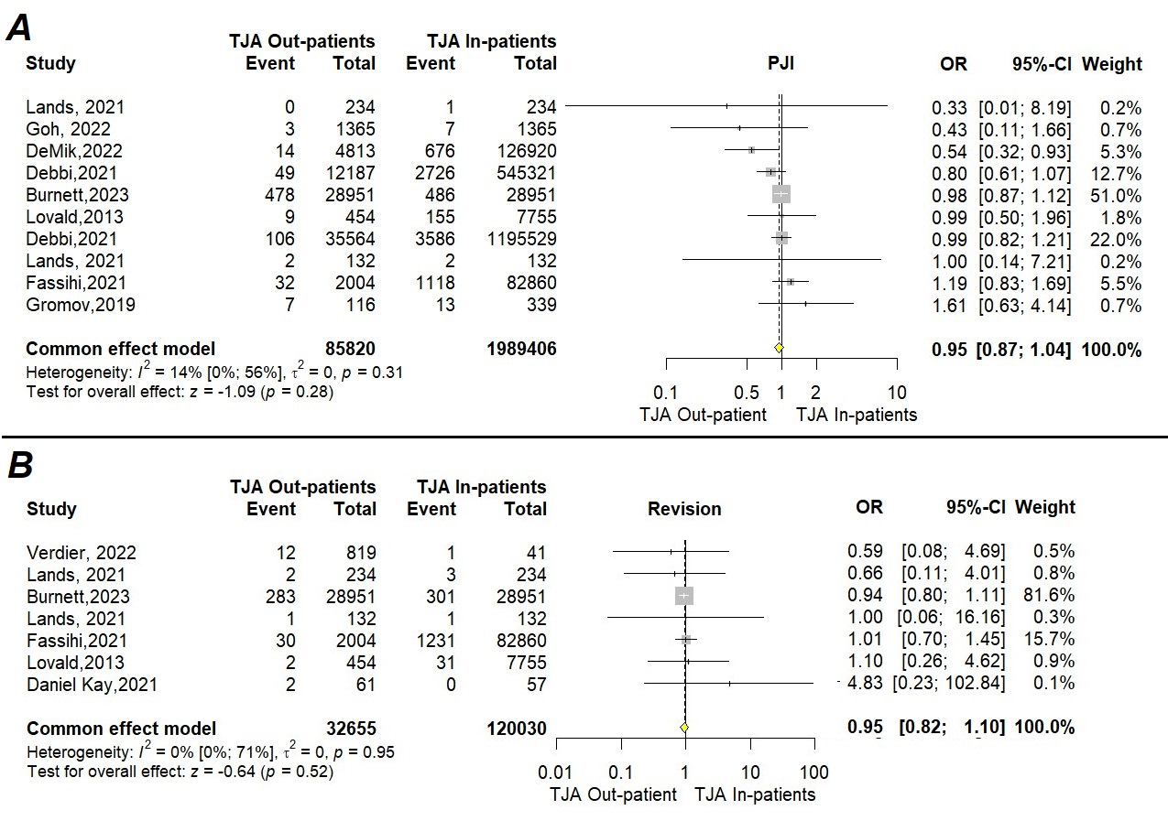
Figure 3- PJI and Revision among outpatient and inpatient TJA
Figure 4- Total cost among outpatient and inpatient TJA

Slide 12
Question:
Is outpatient total joint arthroplasty more beneficial than inpatient TJA?
Response:
Yes.
Outpatient total joint arthroplasty is a safe and effective option for carefully selected patients, offering lower complication rates, reduced readmissions, and significant cost savings.

